Slide 1
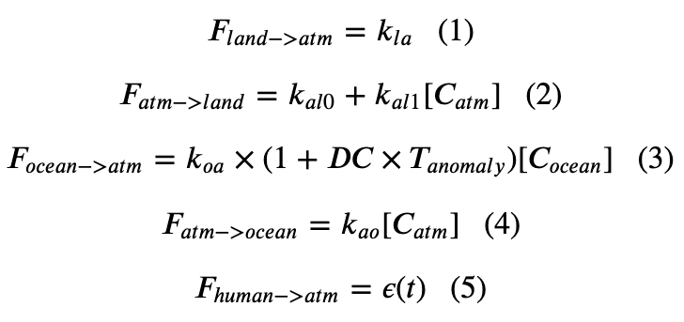
Recap: Cambio 3.0 accounts for ice-albedo feedback

Slide 2
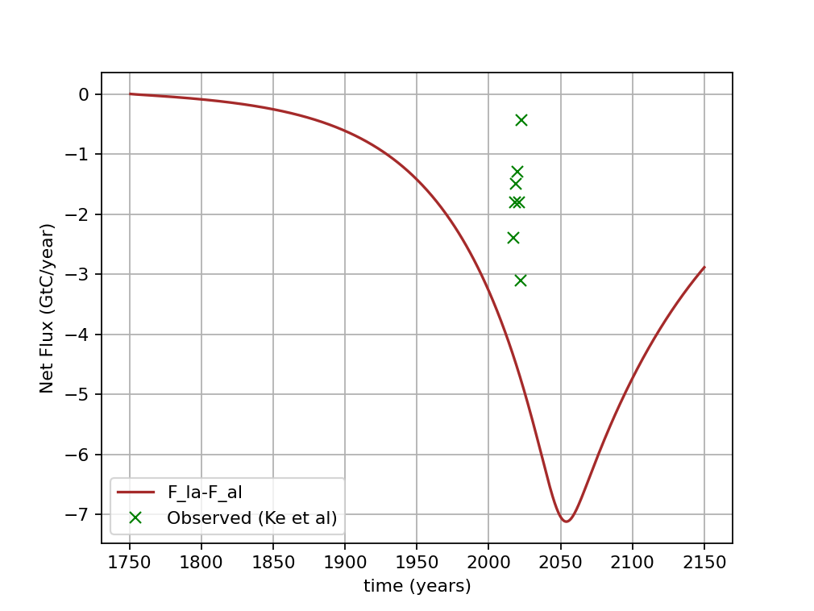
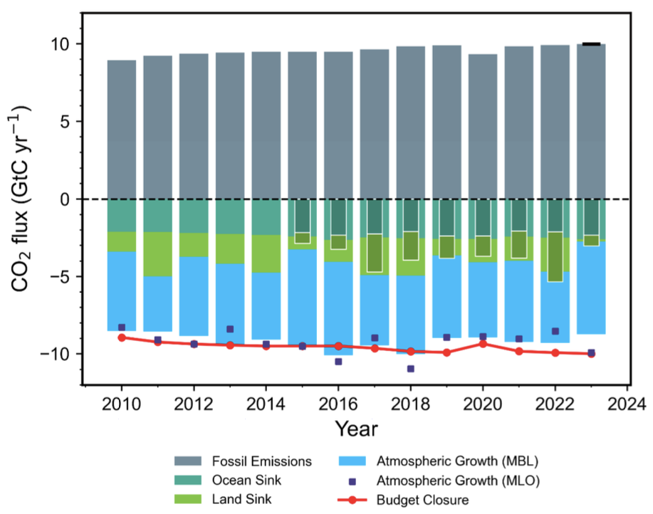
But Ke et al are saying that the CO2 fertilization of Cambio 3.0 is impaired
Ke et al’s Carbon budget from 2010-2023.

Slide 3
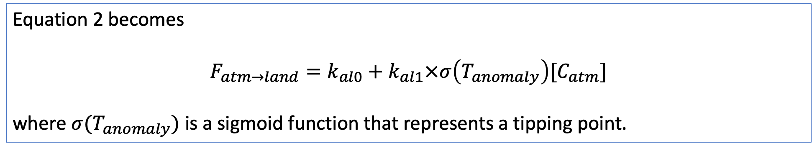
How Cambio 4.0 accounts for impairment of $CO_{2}$fertilization
Equation 2 becomes
$$F_{atm→land}=k_{al0}+k_{al1}×σ\left(T_{anomaly}\right)[C_{atm}]$$
where $σ(T_{anomaly})$ is a sigmoid function that represents a tipping point.

Slide 4
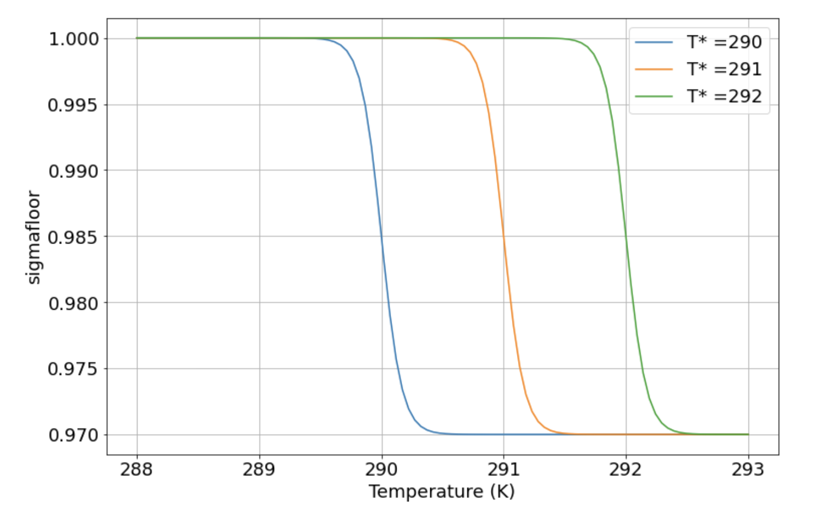
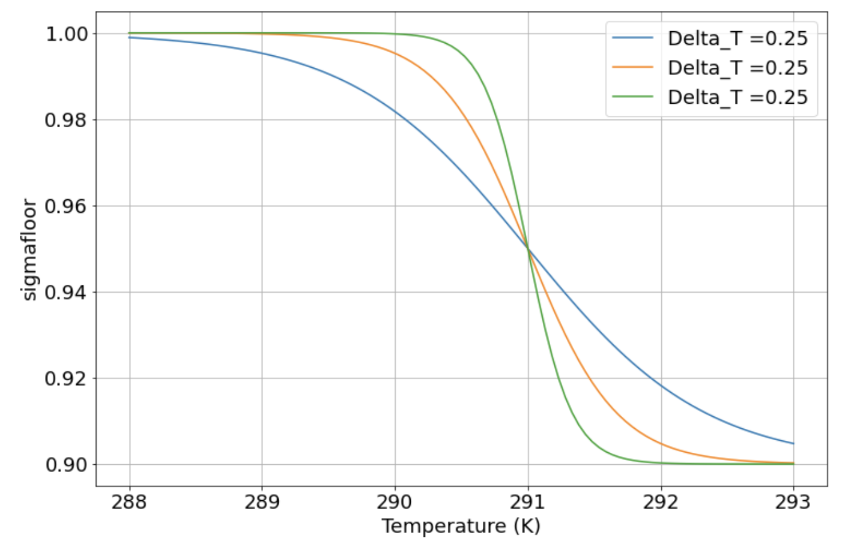
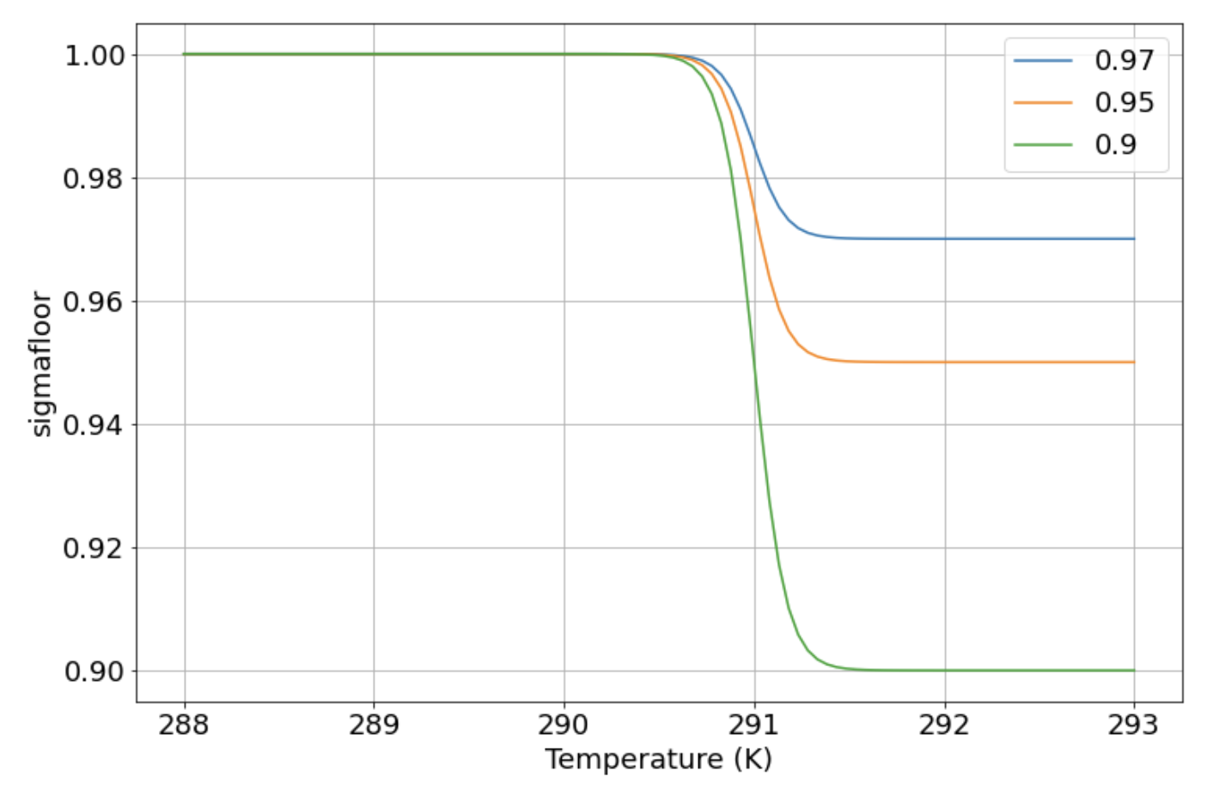



Remember these are our sigmoid parameters
$T_{trans}$
$T_{interval}$
$$σ_{floor}$$

Slide 5
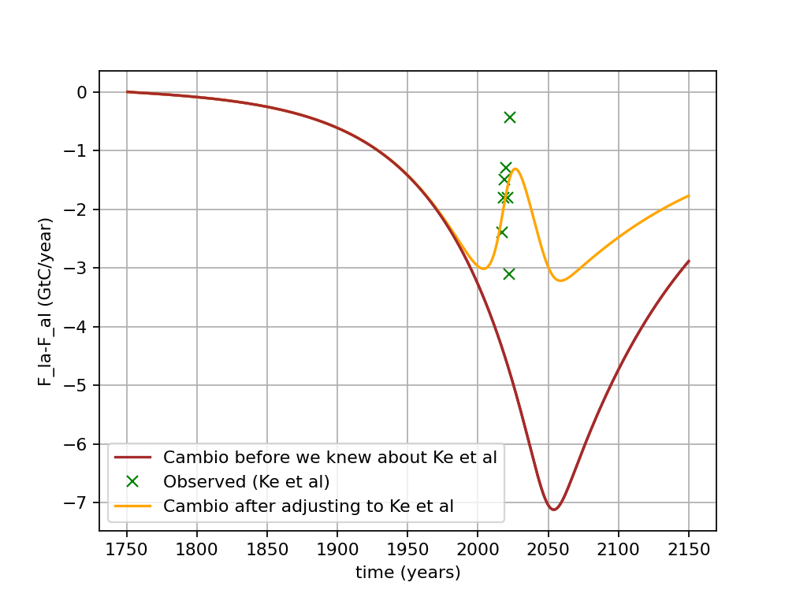
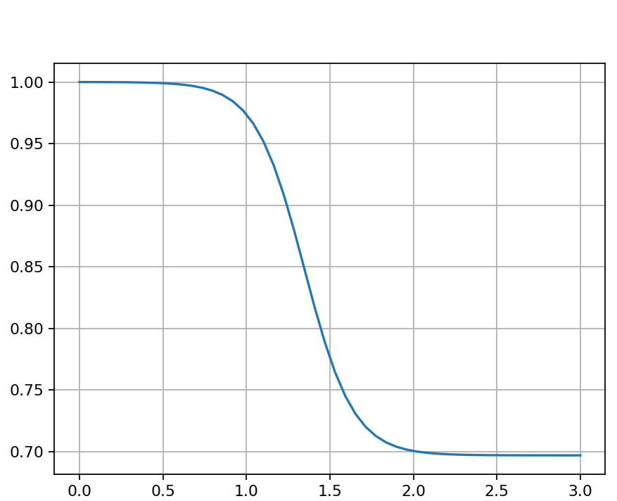
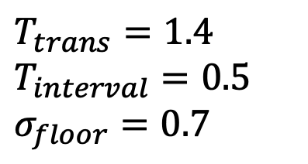
These sigmoid parameters give the best match of Cambio 4.0 to Ke et al
$$F_{atm→land}=k_{al0}+k_{al1}×σ\left(T_{anomaly}\right)[C_{atm}]$$
Ke et al’s Carbon budget from 2010-2023.
$T_{trans}=1.4$
$T_{interval}=0.5$
$σ_{floor}=0.7$

Slide 6
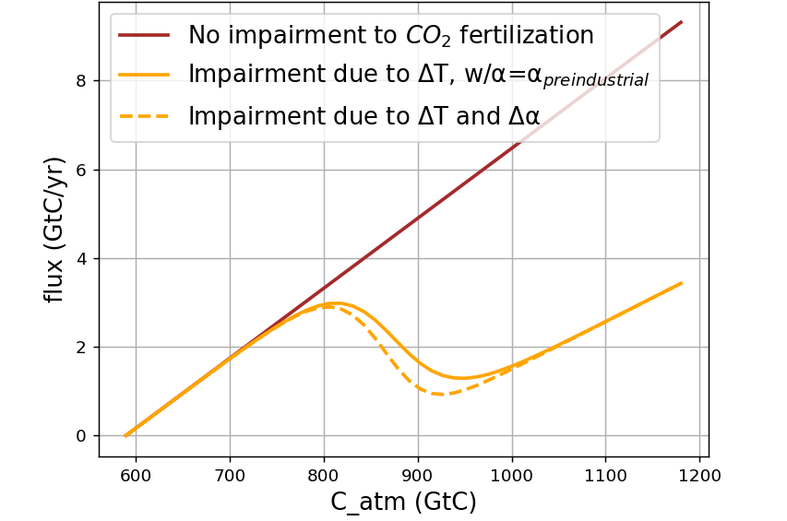
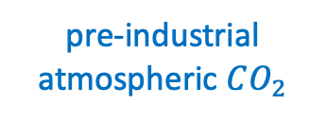
Using $σ_{floor}(T)$ to implement temperature-dependent impairment of $CO_{2}$fertilization
Ke et al’s Carbon budget from 2010-2023.
pre-industrial atmospheric $CO_{2}$
2003
2023

Slide 7
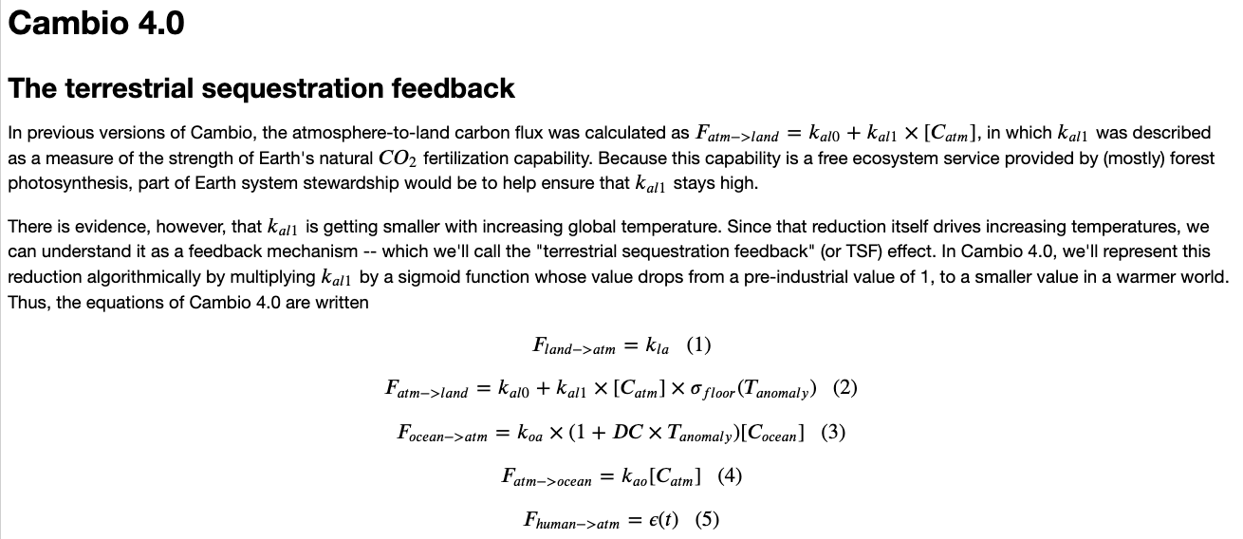
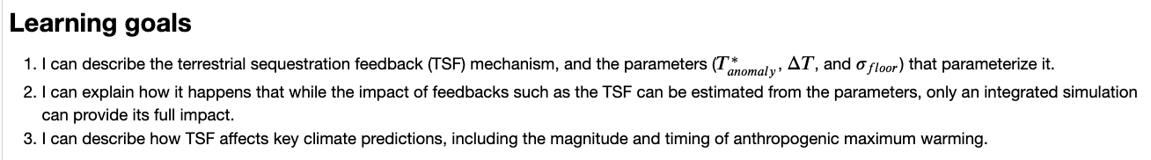
OK, let’s get started

